Slide 1
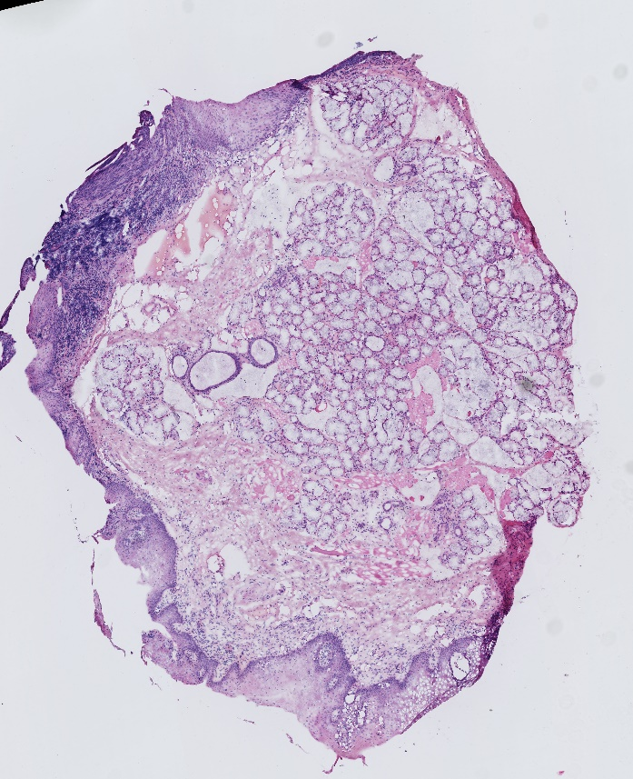
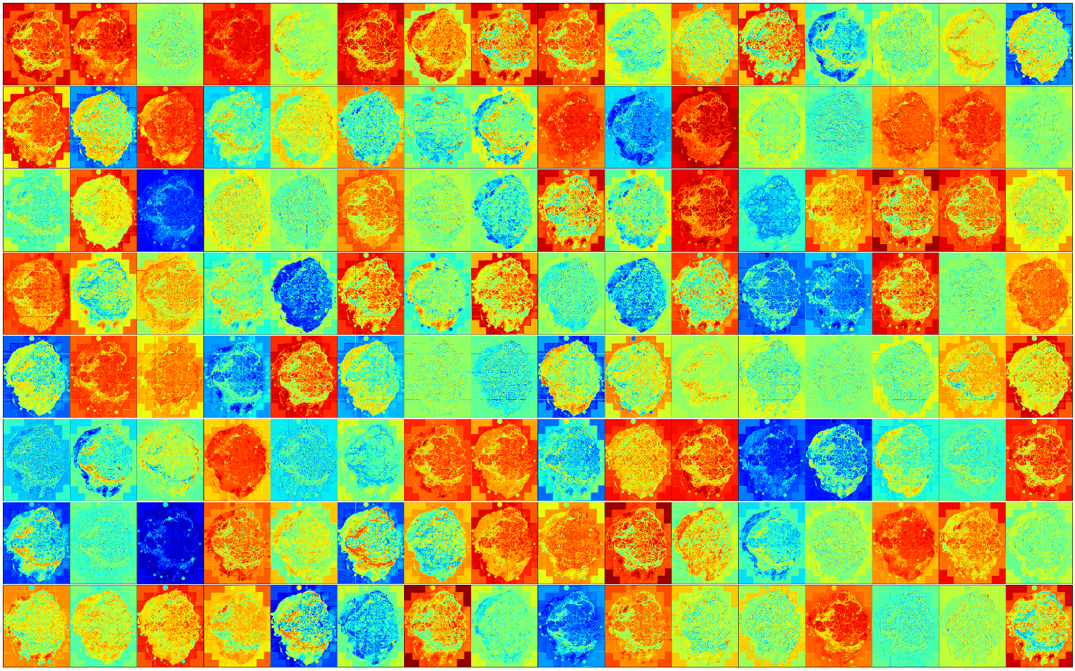
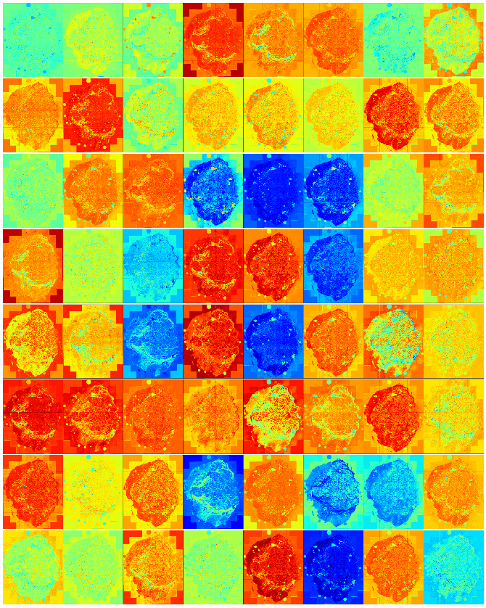
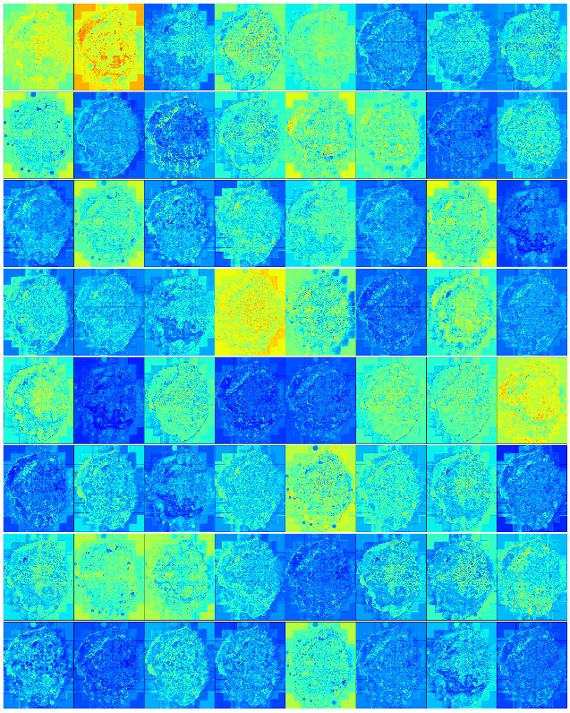
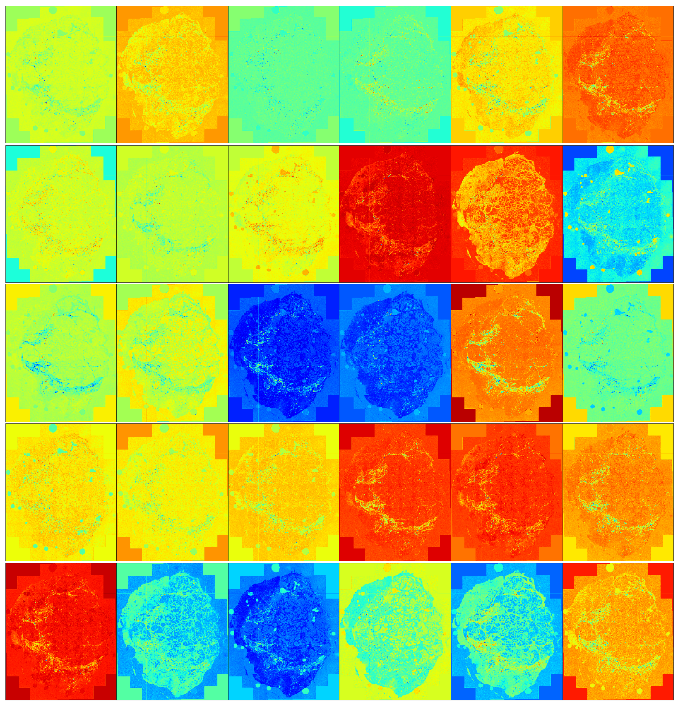
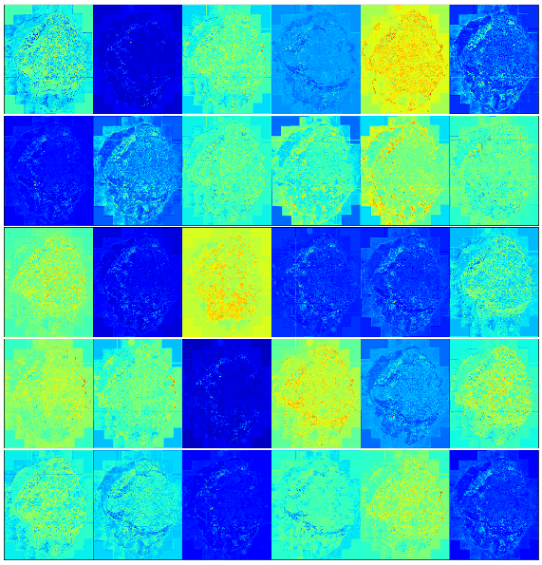
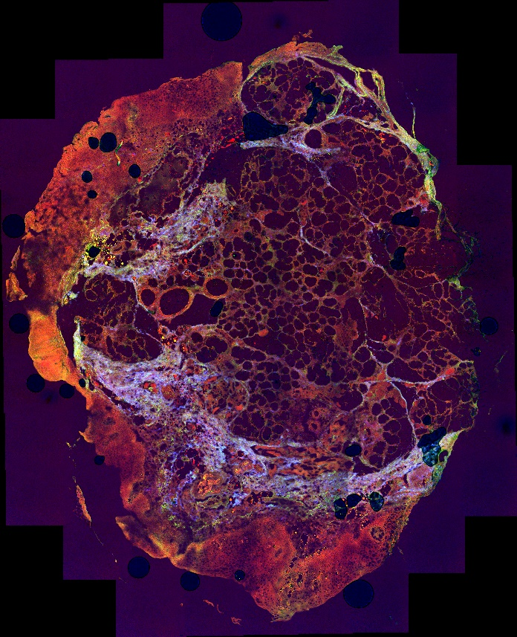
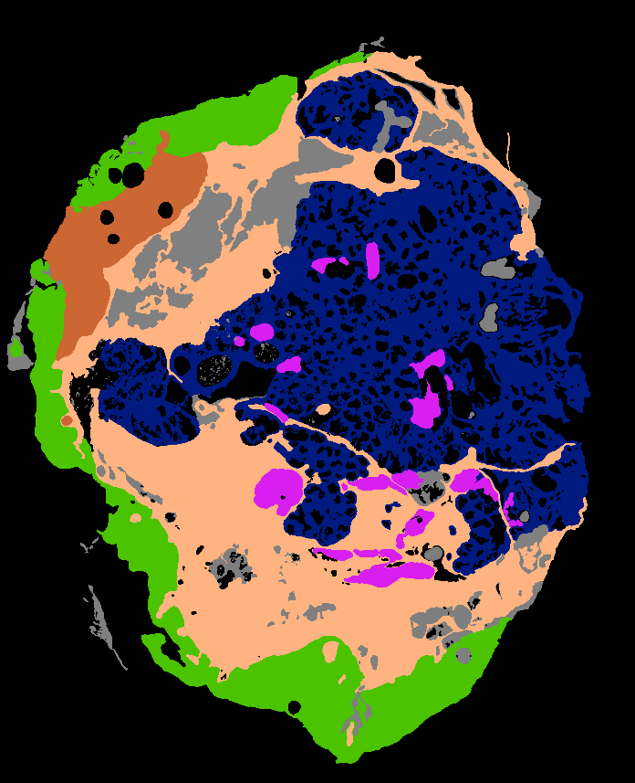
Deep Learning for Image Analysis
Bjarne Thorsted
bjarnet@bmb.sdu.dk

Slide 2

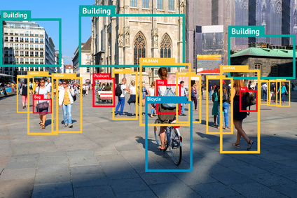
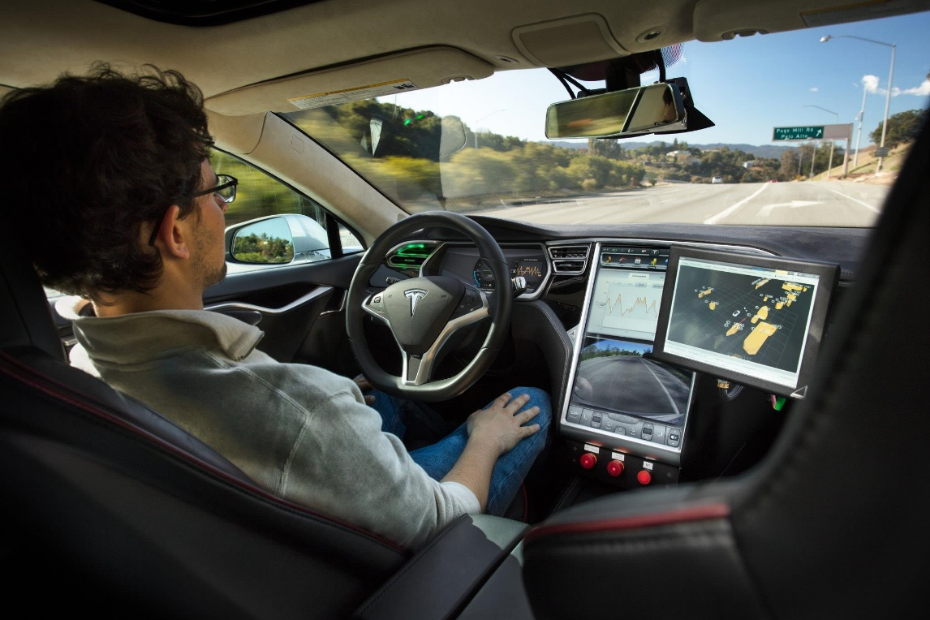

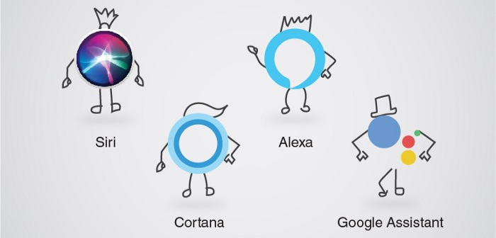
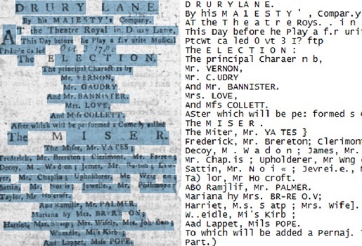
Deep Learning is everywhere

Slide 3
Deep Learning is everywhere

Slide 4
Deep Learning is everywhere

Slide 5

Deep Learning is everywhere

Slide 6
Deep Learning is everywhere

Slide 7
Deep Learning is everywhere

Slide 8
Deep Learning is everywhere

Slide 9
Deep Learning is everywhere

Slide 10
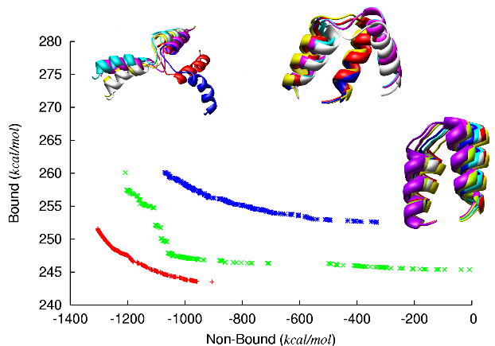
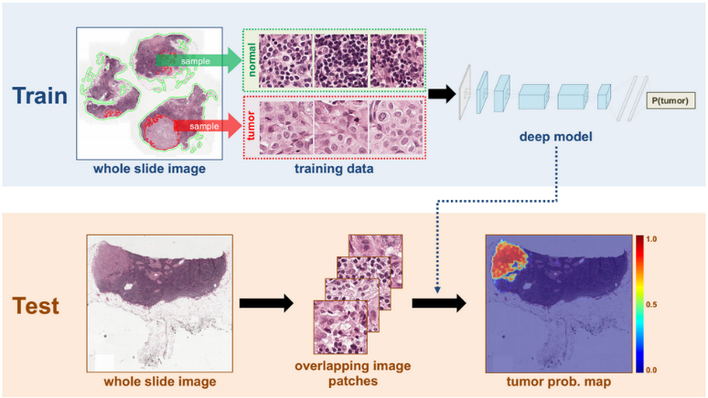
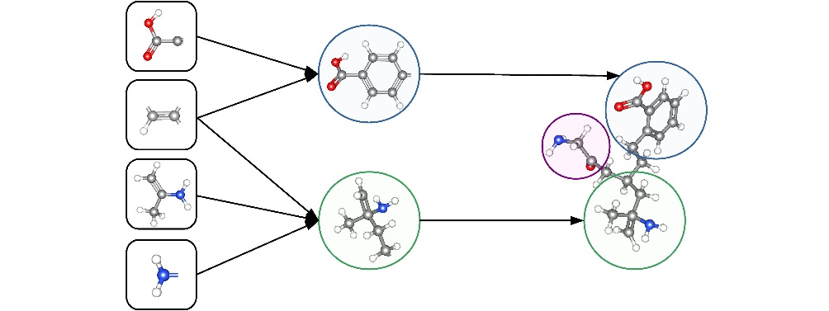
Also in biomedical science

Slide 11

Also in biomedical science
Notes:
Predicting protein folding

Slide 12

Also in biomedical science
Notes:
Drug toxicity

Slide 13

Also in biomedical science
Notes:
Cancer detection – my field

Slide 14
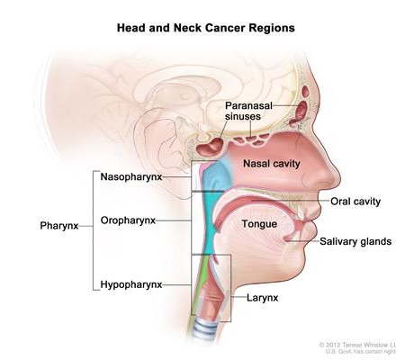
Cancer of the Head and Neck
Half a million new cases annually
Over 350.000 deaths every year
Primary causes:
Alcohol
Tobacco
HPV
Early stage cure rate: 60-95 %
Late stage cure rate: 25 %

Slide 15
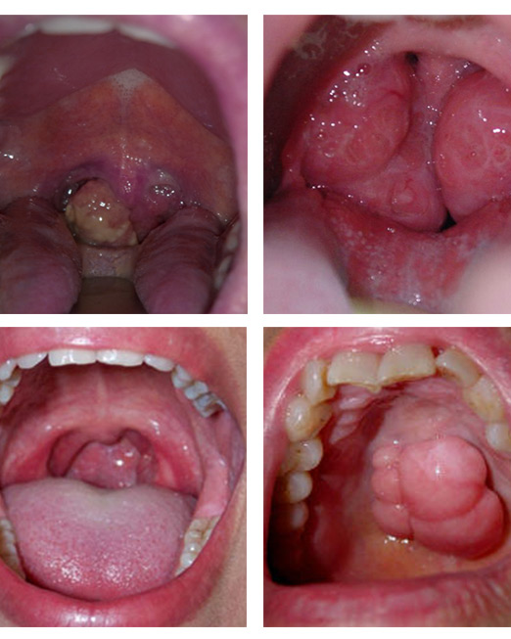
Symptoms
Changed voice
Trouble swallowing
Sore throat
Constant need to clear throat
Persistent cough (may be bloody)
Swollen lymph nodes
Wheezing
Ear pain
hoarseness
Early stages difficult to detect

Slide 16
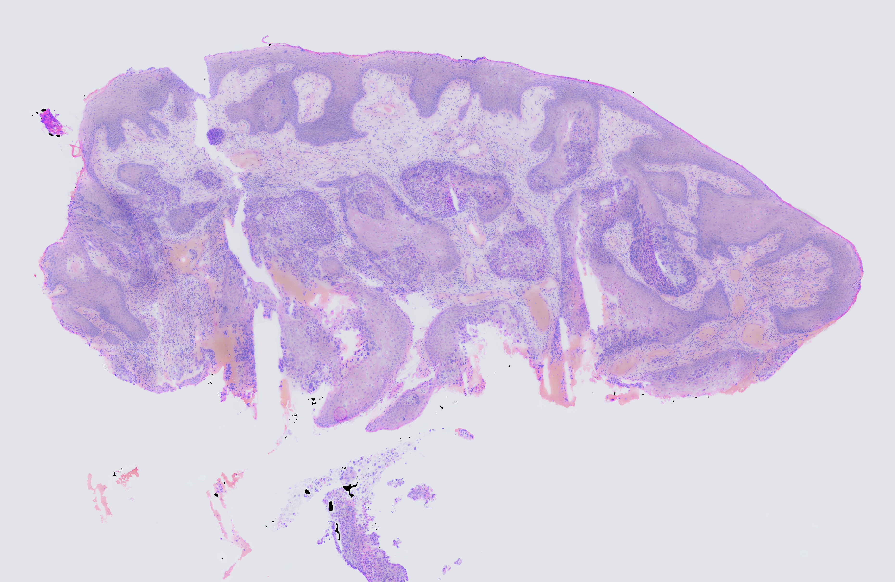
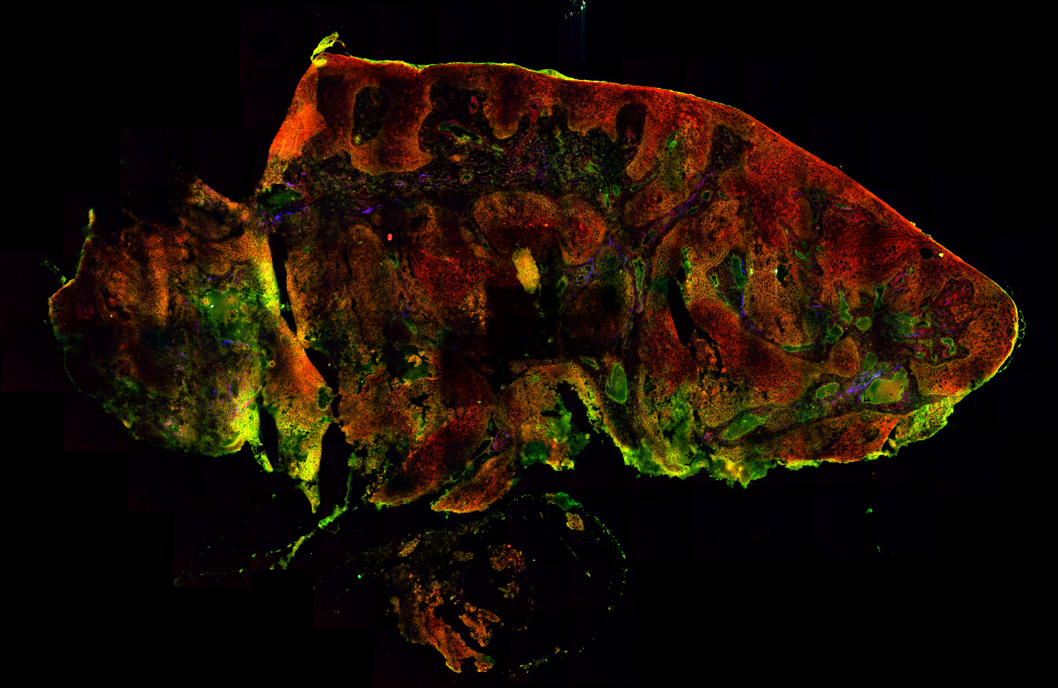
Diagnosis
Tests and exams depending on symptoms
Confirmation of cancer requires biopsy micrograph
High-quality biopsy preparation is time-consuming
Diagnosis can be tricky if the tumor is highly differentiated
Squamous epithelum
Tumor cells
Stromal inflammation

Slide 17
Treatment
Surgery (followed by chemoradiotherapy)
Tricky area with subtle interface
Requires intraoperative histopathological assessment (outside OR):
Macroscopic evaluation
Tissue coloring
Microscopic examination
Squamous epithelum
Tumor cells
Stromal inflammation

Slide 18
Project Aim
Squamous epithelum
Tumor cells
Create a tool to speed up diagnosis
Fast label-free image acquisition from tissue
Use machine learning to handle diagnosis
Stromal inflammation
Notes:
HNSCC is a problem
Diagnosis is time consuming
We want to shave the time using advanced microscopy and machine learning

Slide 19
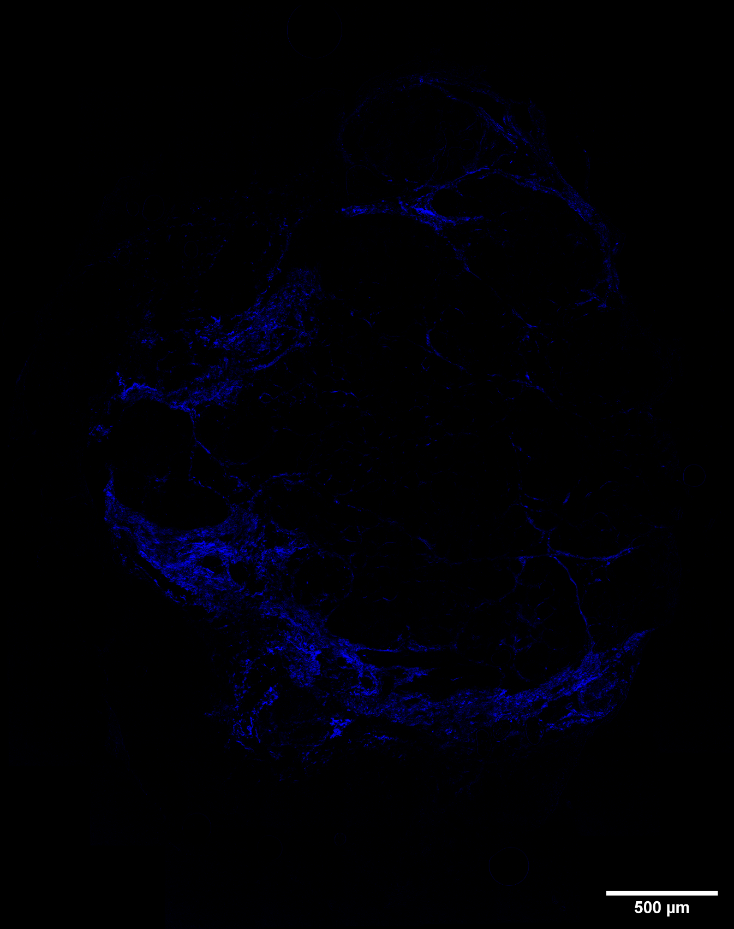
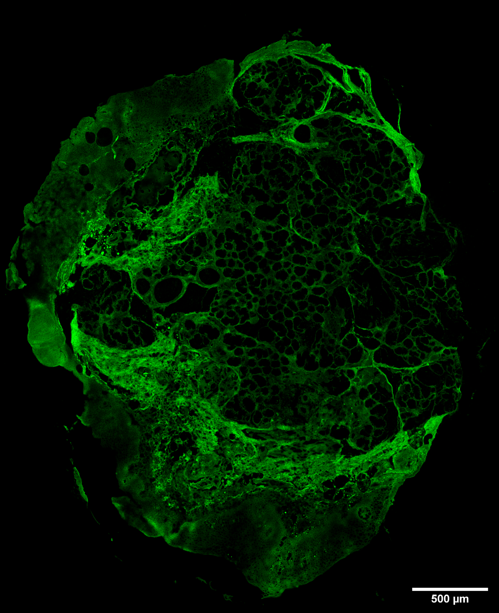
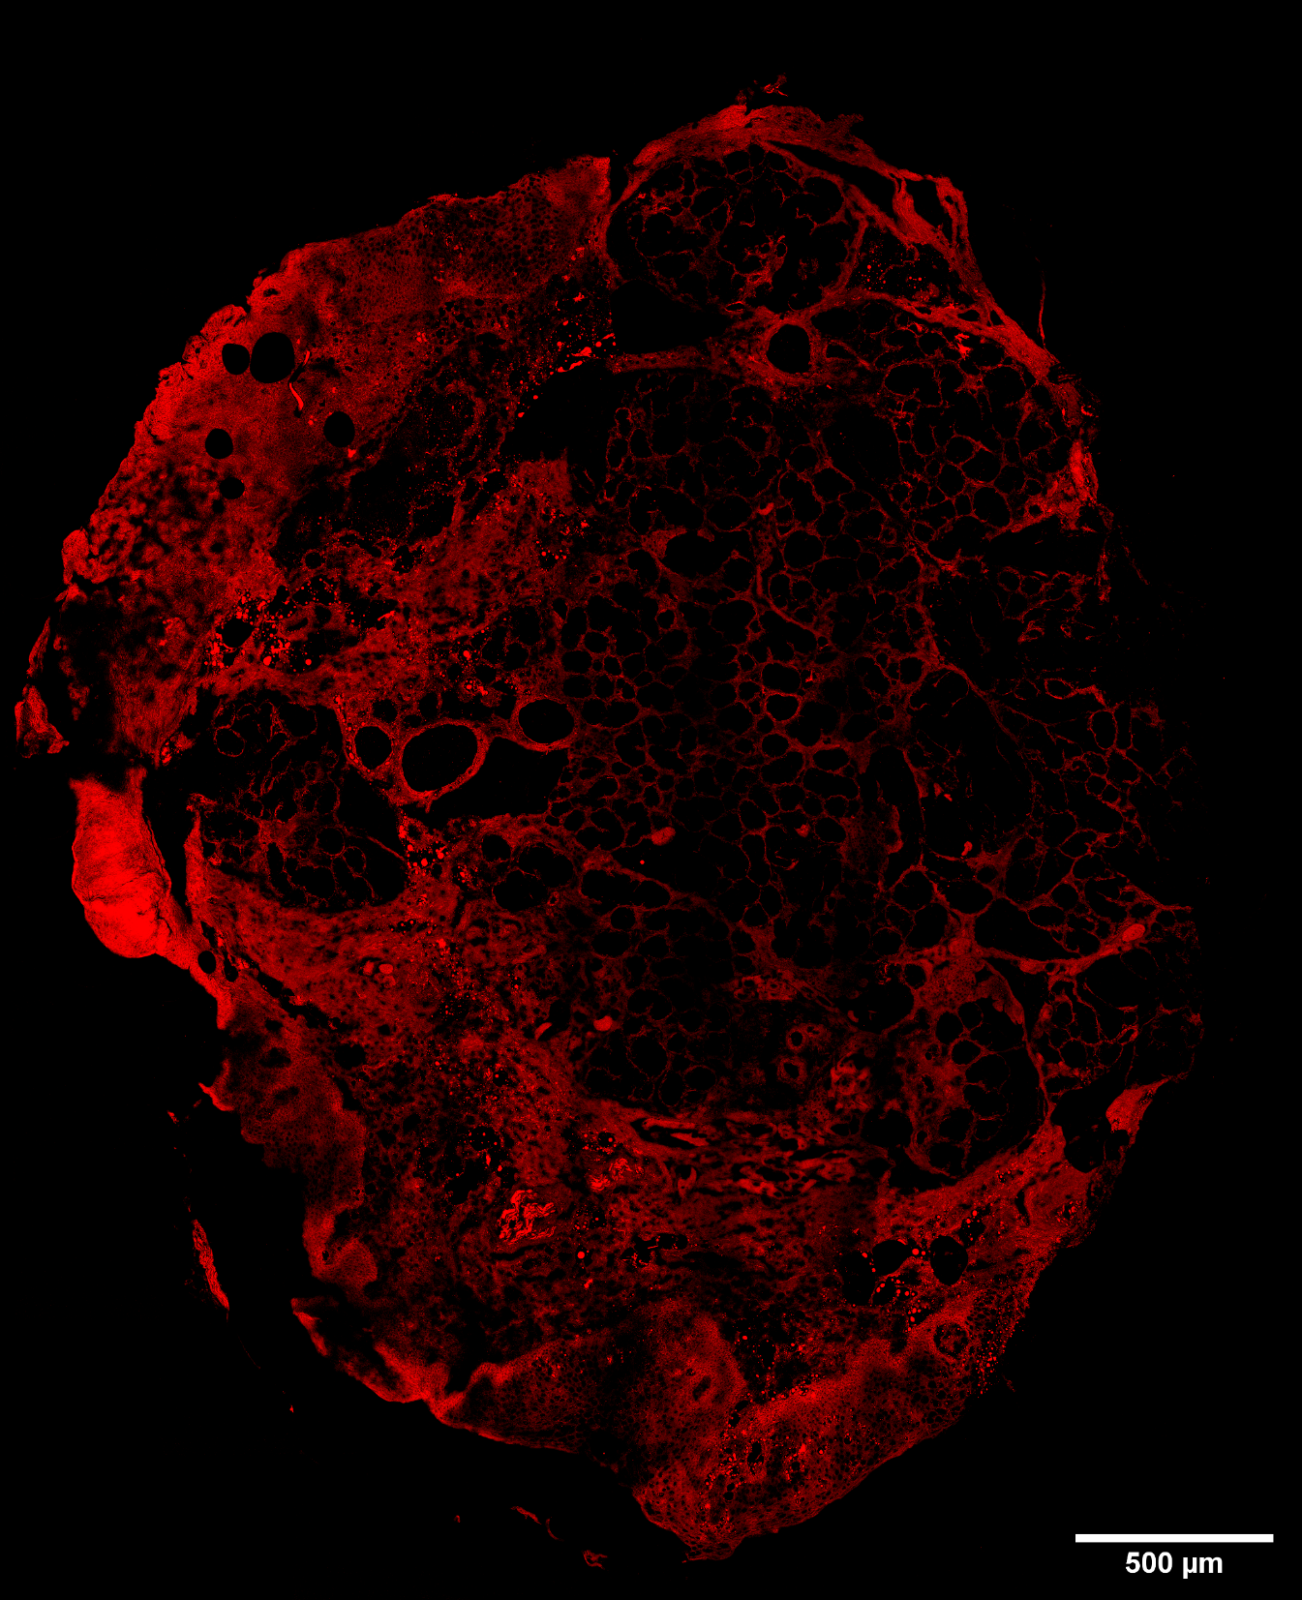
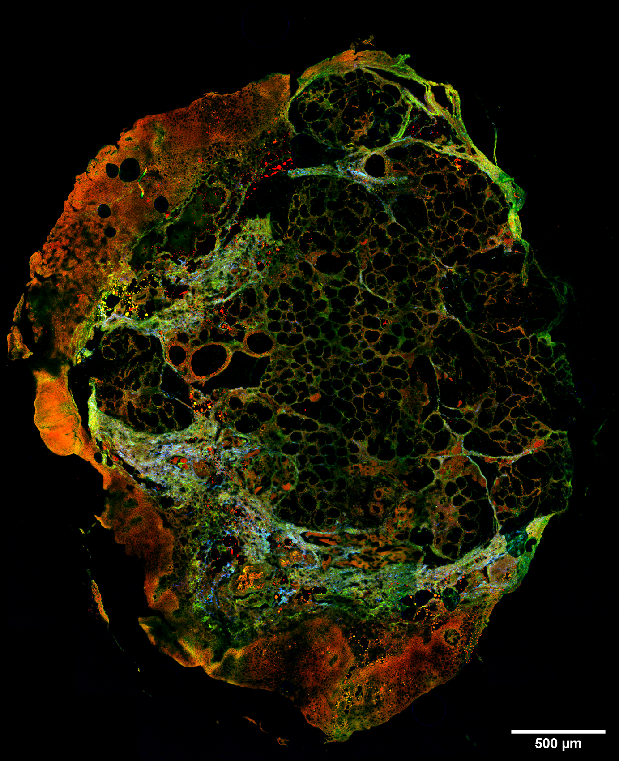
Multi-Modal Imaging
Advanced optical microscopy:
Coherent Anti-stokes Raman Scattering (CARS)
Red: Lipids + non-resonant background using CARS

Slide 20


Multi-Modal Imaging
Advanced optical microscopy:
Second Harmonic Generation (SHG)
Blue: collagen using SHG

Slide 21
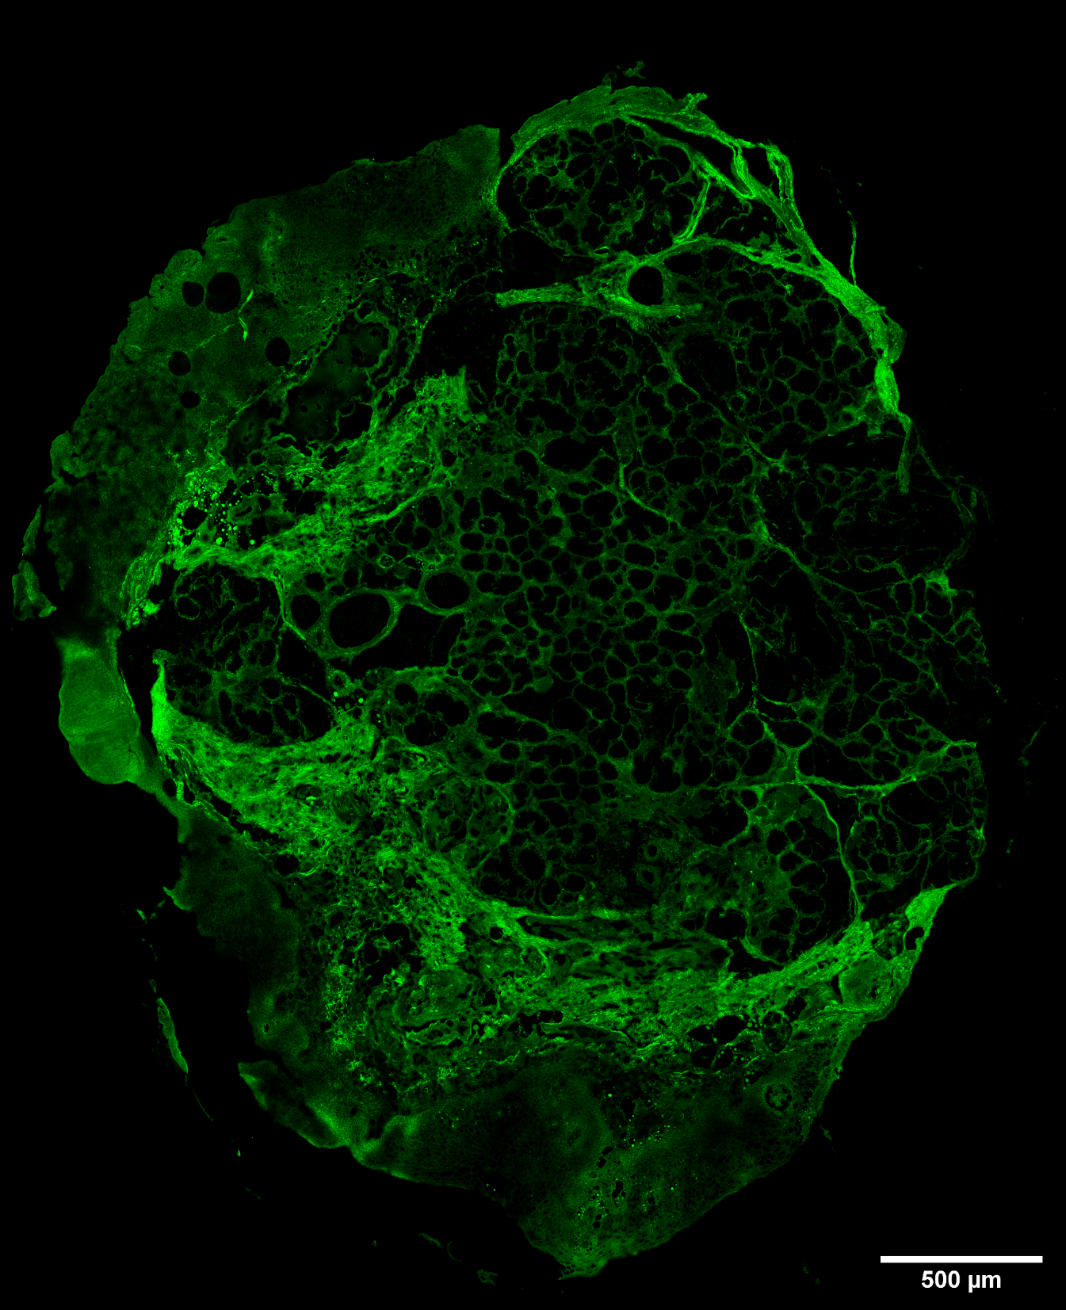

Multi-Modal Imaging
Advanced optical microscopy:
Two-Photon Excited Fluorescence (TPEF)
Green: Autofluorescence using TPEF

Slide 22

Multi-Modal Imaging
Advanced optical microscopy:
Coherent Anti-stokes Raman Scattering (CARS)
Second Harmonic Generation (SHG)
Two-Photon Excited Fluorescence (TPEF)
Red: Lipids + non-resonant background using CARS
Blue: collagen using SHG
Green: Autofluorescence using TPEF

Slide 23
Multi-Modal Imaging
Advanced optical microscopy:
Coherent Anti-stokes Raman Scattering (CARS)
Second Harmonic Generation (SHG)
Two-Photon Excited Fluorescence (TPEF)
Red: Lipids + non-resonant background using CARS
Blue: collagen using SHG
Green: Autofluorescence using TPEF

Slide 24
Multi-Modal Imaging
Advanced optical microscopy:
Coherent Anti-stokes Raman Scattering (CARS)
Second Harmonic Generation (SHG)
Two-Photon Excited Fluorescence (TPEF)
Red: Lipids + non-resonant background using CARS
Blue: collagen using SHG
Green: Autofluorescence using TPEF

Slide 25
Multi-Modal Imaging
Advanced optical microscopy:
Coherent Anti-stokes Raman Scattering (CARS)
Second Harmonic Generation (SHG)
Two-Photon Excited Fluorescence (TPEF)
Red: Lipids + non-resonant background using CARS
Blue: collagen using SHG
Green: Autofluorescence using TPEF

Slide 26
Multi-Modal Imaging
Advanced optical microscopy:
Coherent Anti-stokes Raman Scattering (CARS)
Second Harmonic Generation (SHG)
Two-Photon Excited Fluorescence (TPEF)
Red: Lipids + non-resonant background using CARS
Blue: collagen using SHG
Green: Autofluorescence using TPEF

Slide 27

Comparison with Hematoxylin & Eosin
CARS/SHG/TPEF
Nuclei as silhuettes
Cell membranes in bright red
Cytoplasm in dark red
Muscles in red
Inflammation in green
Collagen in blue
H&E
Nuclei in blue/purple
Basophils in purplish red
Cytoplasm in red
Muscles in dark red
Erythrocytes in cherry red
Collagen in pale pink
Mitochondria in pale pink

Slide 28

Comparison with Hematoxylin & Eosin
CARS/SHG/TPEF
Nuclei as silhuettes
Cell membranes in bright red
Cytoplasm in dark red
Muscles in red
Inflammation in green
Collagen in blue
H&E
Nuclei in blue/purple
Basophils in purplish red
Cytoplasm in red
Muscles in dark red
Erythrocytes in cherry red
Collagen in pale pink
Mitochondria in pale pink
Segmentation
Green:Epithelium
Brown: inflammation
Beige: Lumen
Blue: glandular tissue
Magenta: muscle
Grey: Other
Black: background

Slide 29

Comparison with Hematoxylin & Eosin
CARS/SHG/TPEF
Nuclei as silhuettes
Cell membranes in bright red
Cytoplasm in dark red
Muscles in red
Inflammation in green
Collagen in blue
H&E
Nuclei in blue/purple
Basophils in purplish red
Cytoplasm in red
Muscles in dark red
Erythrocytes in cherry red
Collagen in pale pink
Mitochondria in pale pink
Segmentation
Green:Epithelium
Brown: inflammation
Beige: Lumen
Blue: glandular tissue
Magenta: muscle
Grey: Other
Black: background
Notes:
Titles for each list

Slide 30
My Machine Learning Journey
Degree in Biophysics
Main field is optical microscopy
Limited coding experience (Mainly MATLAB scripts)
No prior knowledge of machine learning
Only a small selection of complete software packages and plug-ins
Too convoluted or rigid
Too ressource intensive
Insensitive to spatial context
Conclusion: I had to write my own software
Notes:
Snak om færdigsyede softwares og pakker
Nævn de observerede mangler

Slide 31
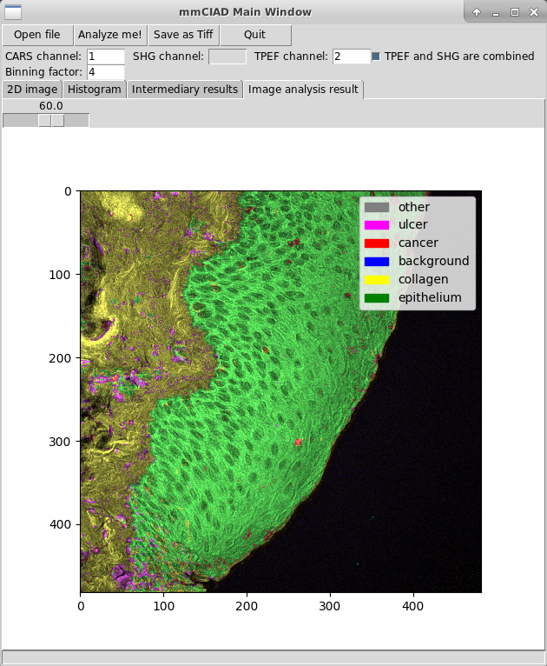
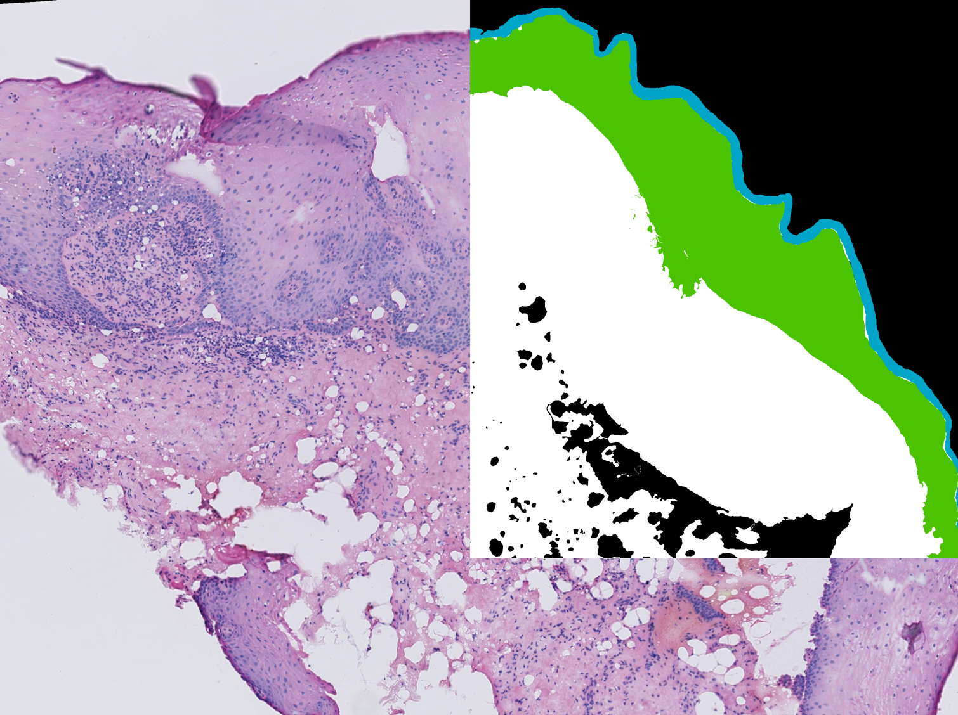
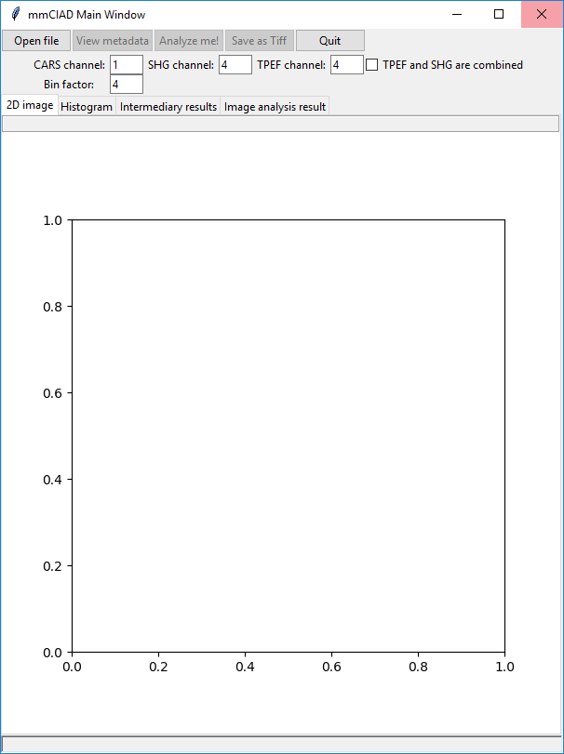
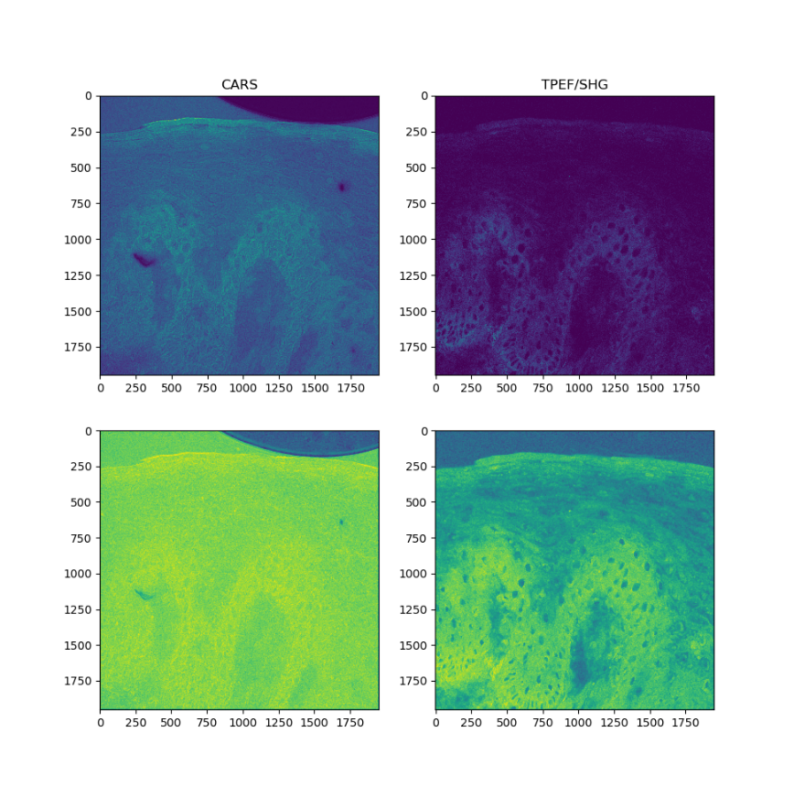
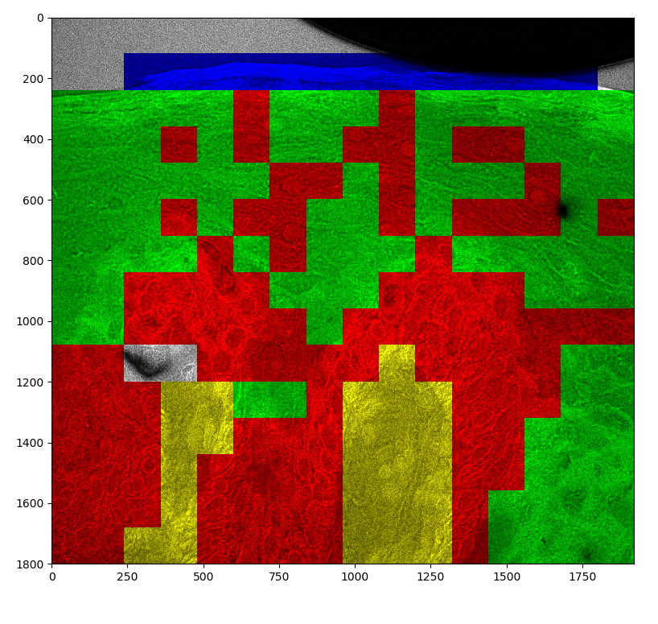
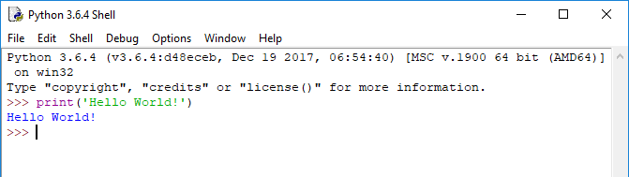
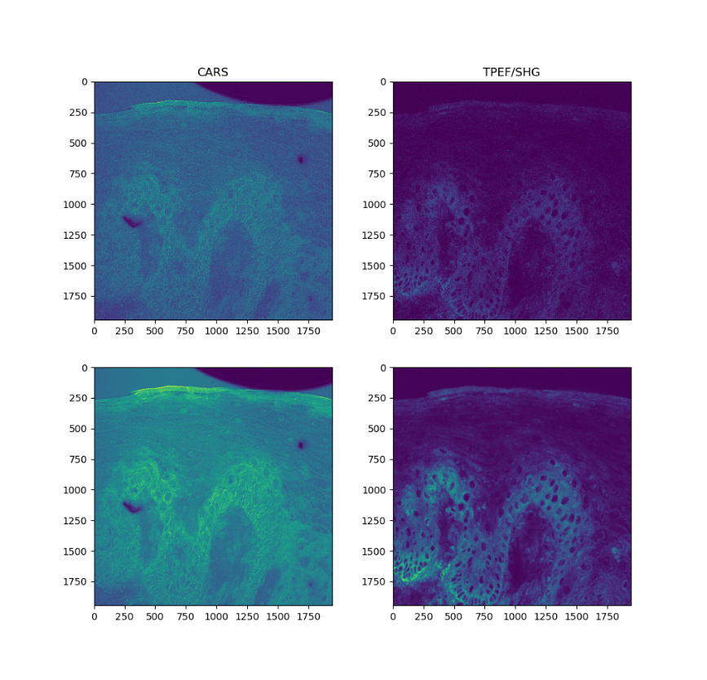
My Machine Learning Journey
Feb 2018: Started learning Python
Apr 2018: Working GUI framework in Python
May 2018: First attempt at machine learning (SVM)
Aug 2018: Added preprocessing (feature extraction)
Sep 2018: Expanded raw data from 2 to 3 channels
Nov 2018: Implemented MLP instead of SVM
Attended Deep Learning course at Mines
ParisTech, France
Dec 2018: Began working on Ground Truth image data
Feb 2019: Functional neural network

Slide 32
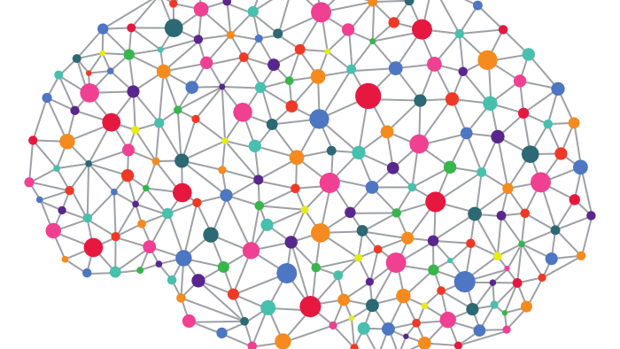
PART I Deep Learning

Slide 33
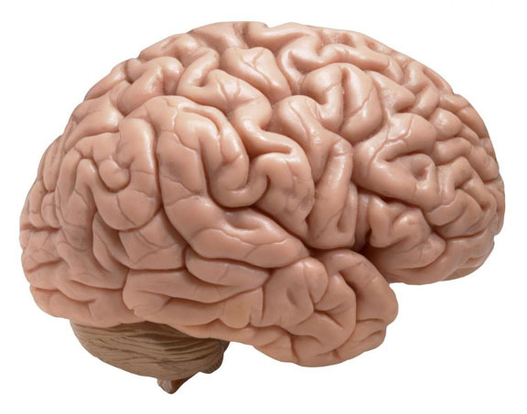
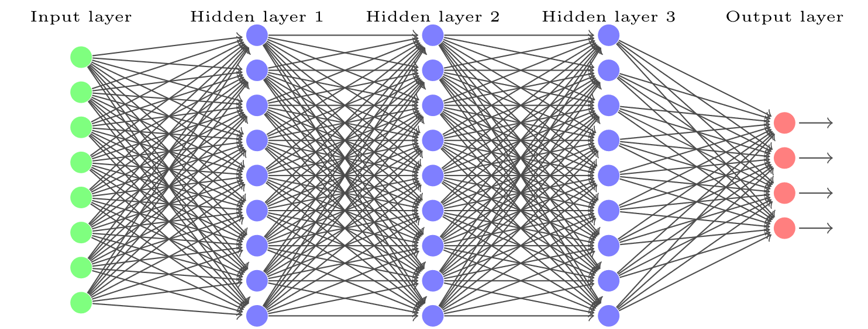
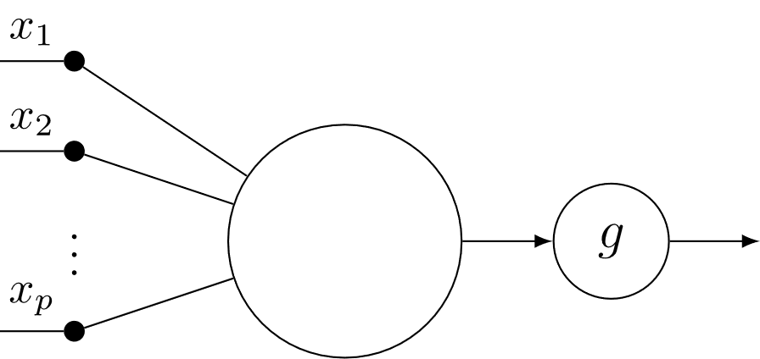
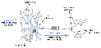
What is a Neural Network?

Slide 34
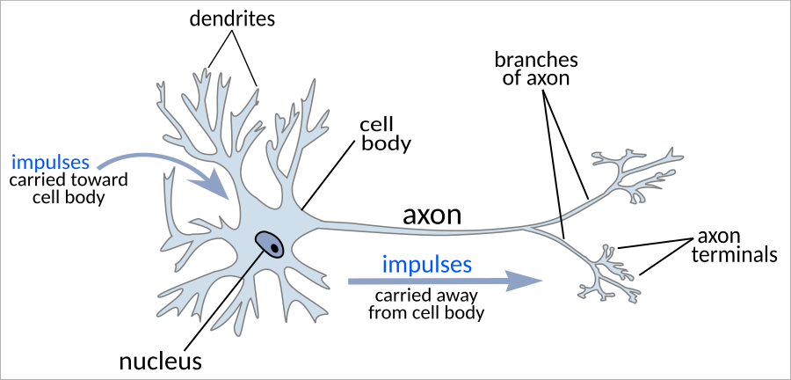
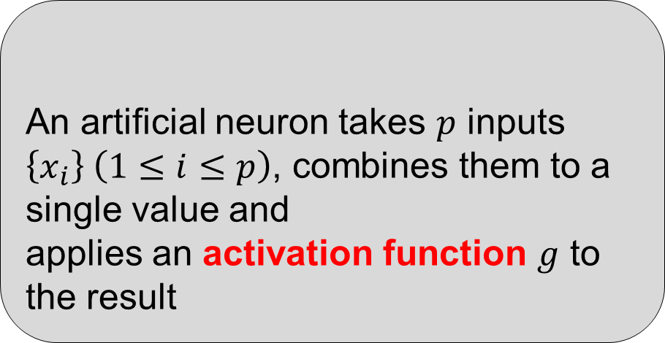
What is a Neural Network?
An artificial neuron takes $p$ inputs $\left\{x_{i}\right\} \left(1≤i≤p\right)$, combines them to a single value and
applies an activation function $g$ to the result
General Principle

Slide 35

The Artificial Neuron
An artificial neuron takes $p$ inputs $\left\{x_{i}\right\} \left(1≤i≤p\right)$, combines them to a single value and
applies an activation function $g$ to the result
General Principle

Slide 36
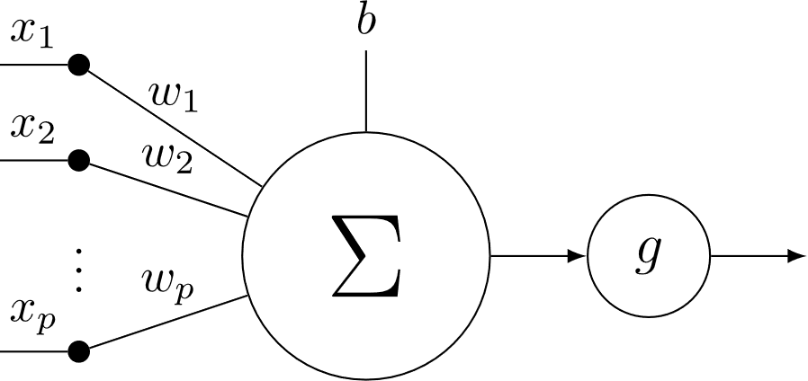
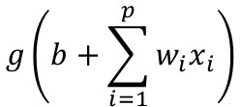
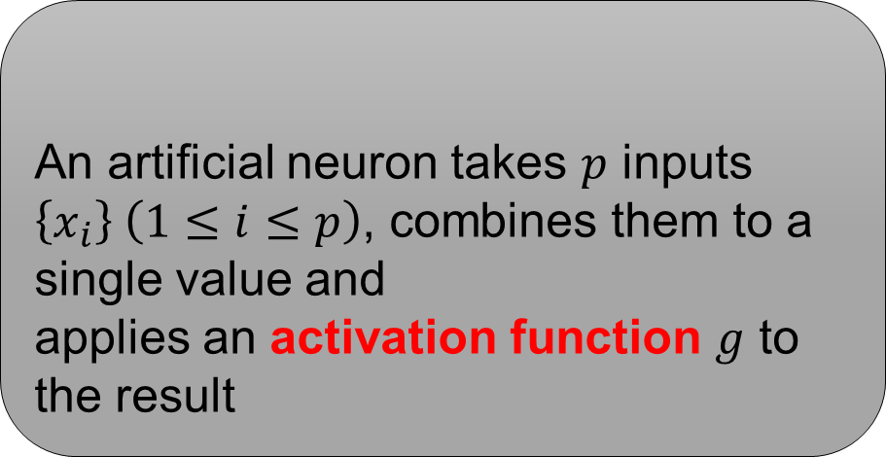
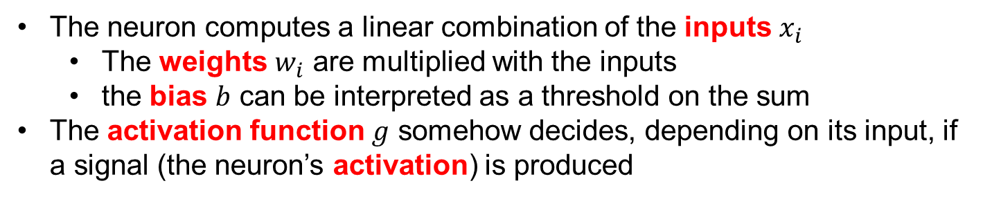
The Modern Artificial Neuron
An artificial neuron takes $p$ inputs $\left\{x_{i}\right\} \left(1≤i≤p\right)$, combines them to a single value and
applies an activation function $g$ to the result
General Principle
$$g\left(b+\sum_{i=1}^{p}{w_{i}x_{i}}\right)$$
The neuron computes a linear combination of the inputs $x_{i}$
The weights $w_{i}$ are multiplied with the inputs
the bias $b$ can be interpreted as a threshold on the sum
The activation function $g$ somehow decides, depending on its input, if a signal (the neuron’s activation) is produced

Slide 37
The Modern Artificial Neuron
An artificial neuron takes $p$ inputs $\left\{x_{i}\right\} \left(1≤i≤p\right)$, combines them to a single value and
applies an activation function $g$ to the result
General Principle
$$g\left(b+\sum_{i=1}^{p}{w_{i}x_{i}}\right)$$
The activation function acts like a gate
Only if its input is high enough will a signal (i.e. other than zero) be produced
It can be interpreted as a source of abstraction: information considered as unimportant is ignored

Slide 38
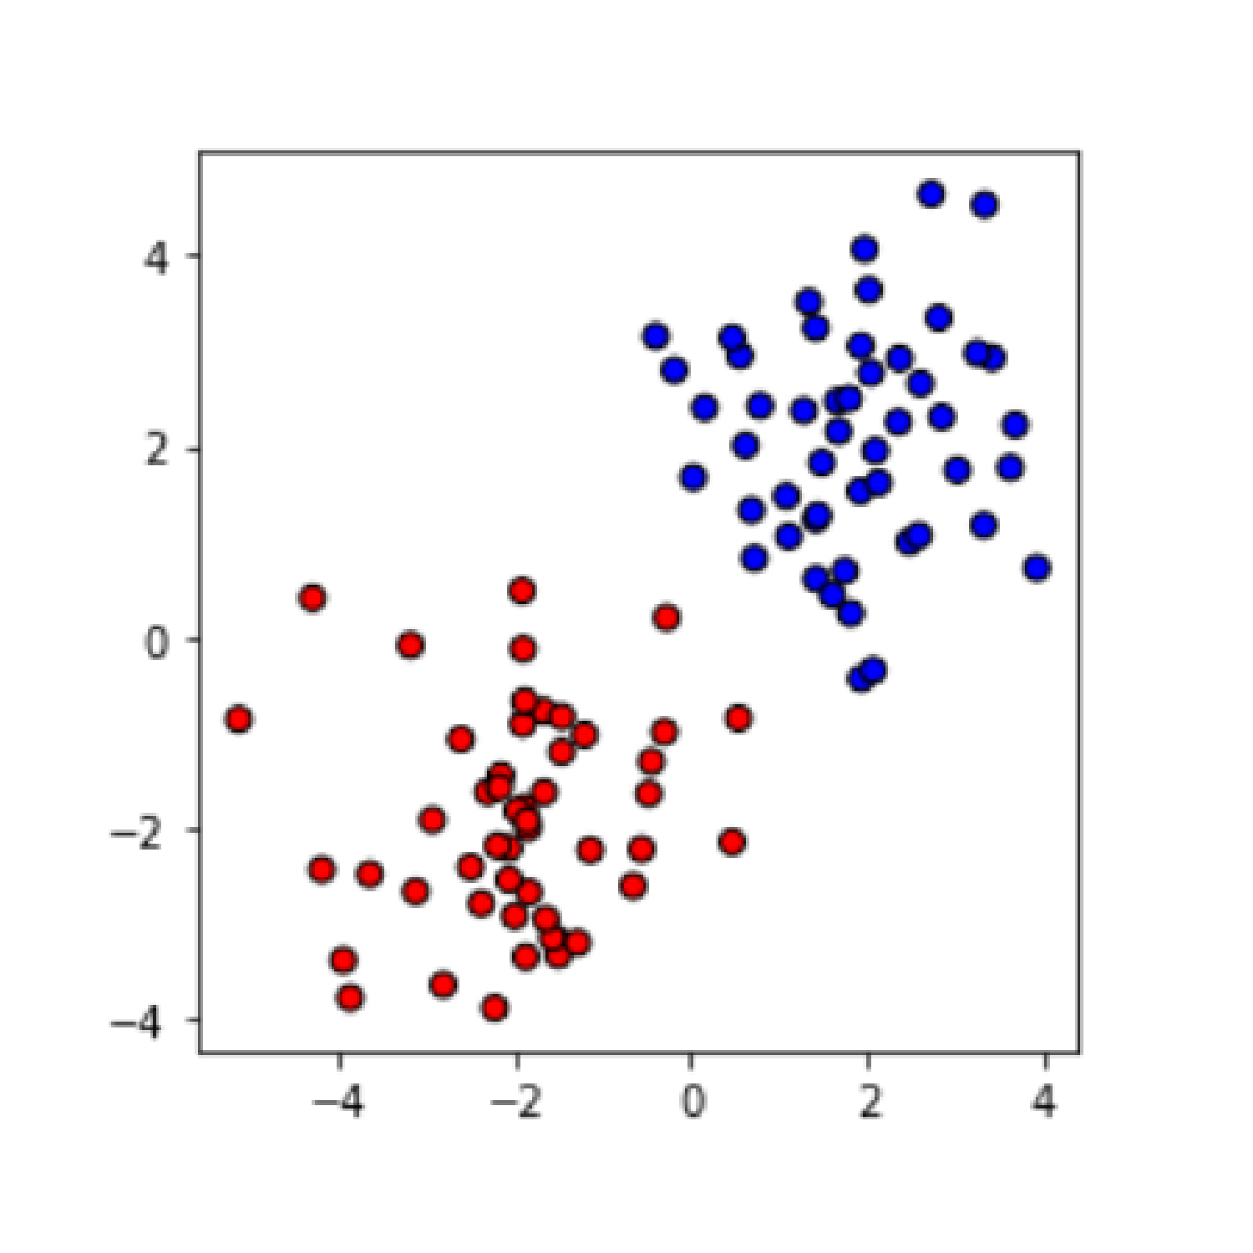
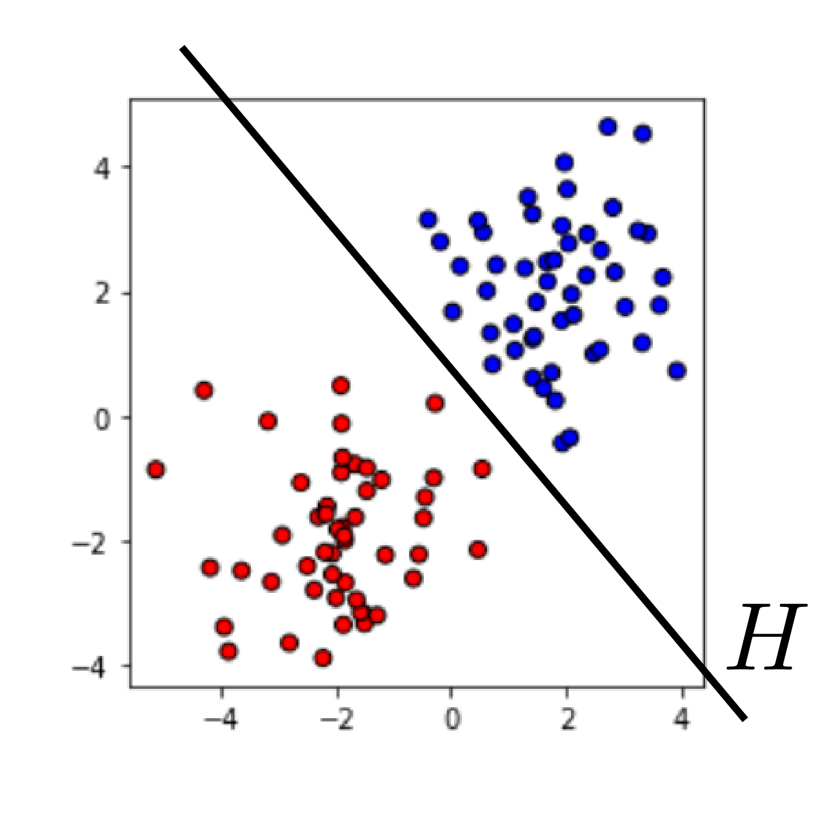
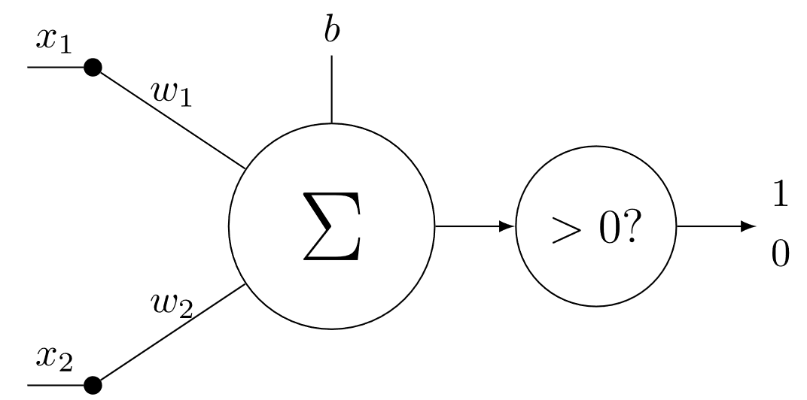
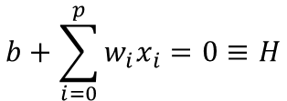
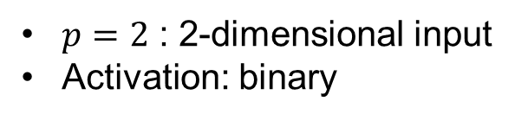
What can we do with a neuron?
$p=2$ : 2-dimensional input
Activation: binary
$$b+\sum_{i=0}^{p}{w_{i}x_{i}=0}≡H$$

Slide 39
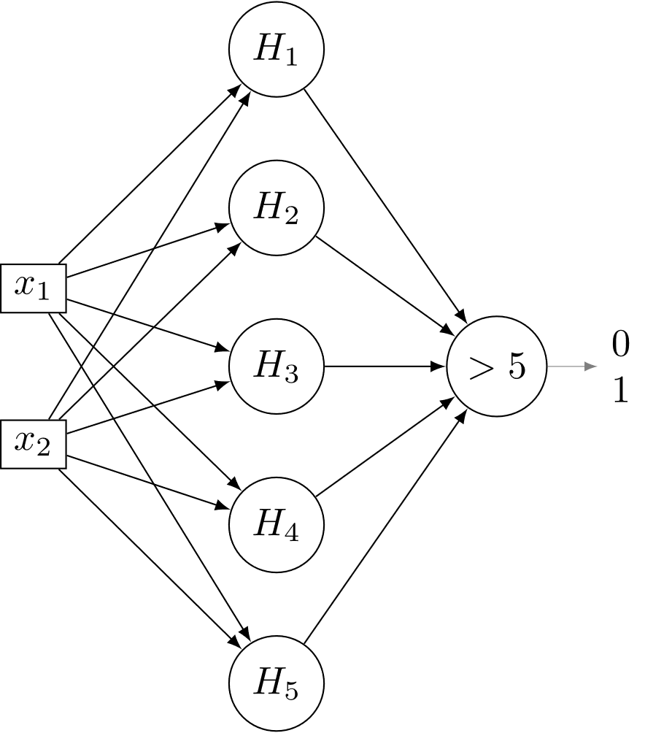
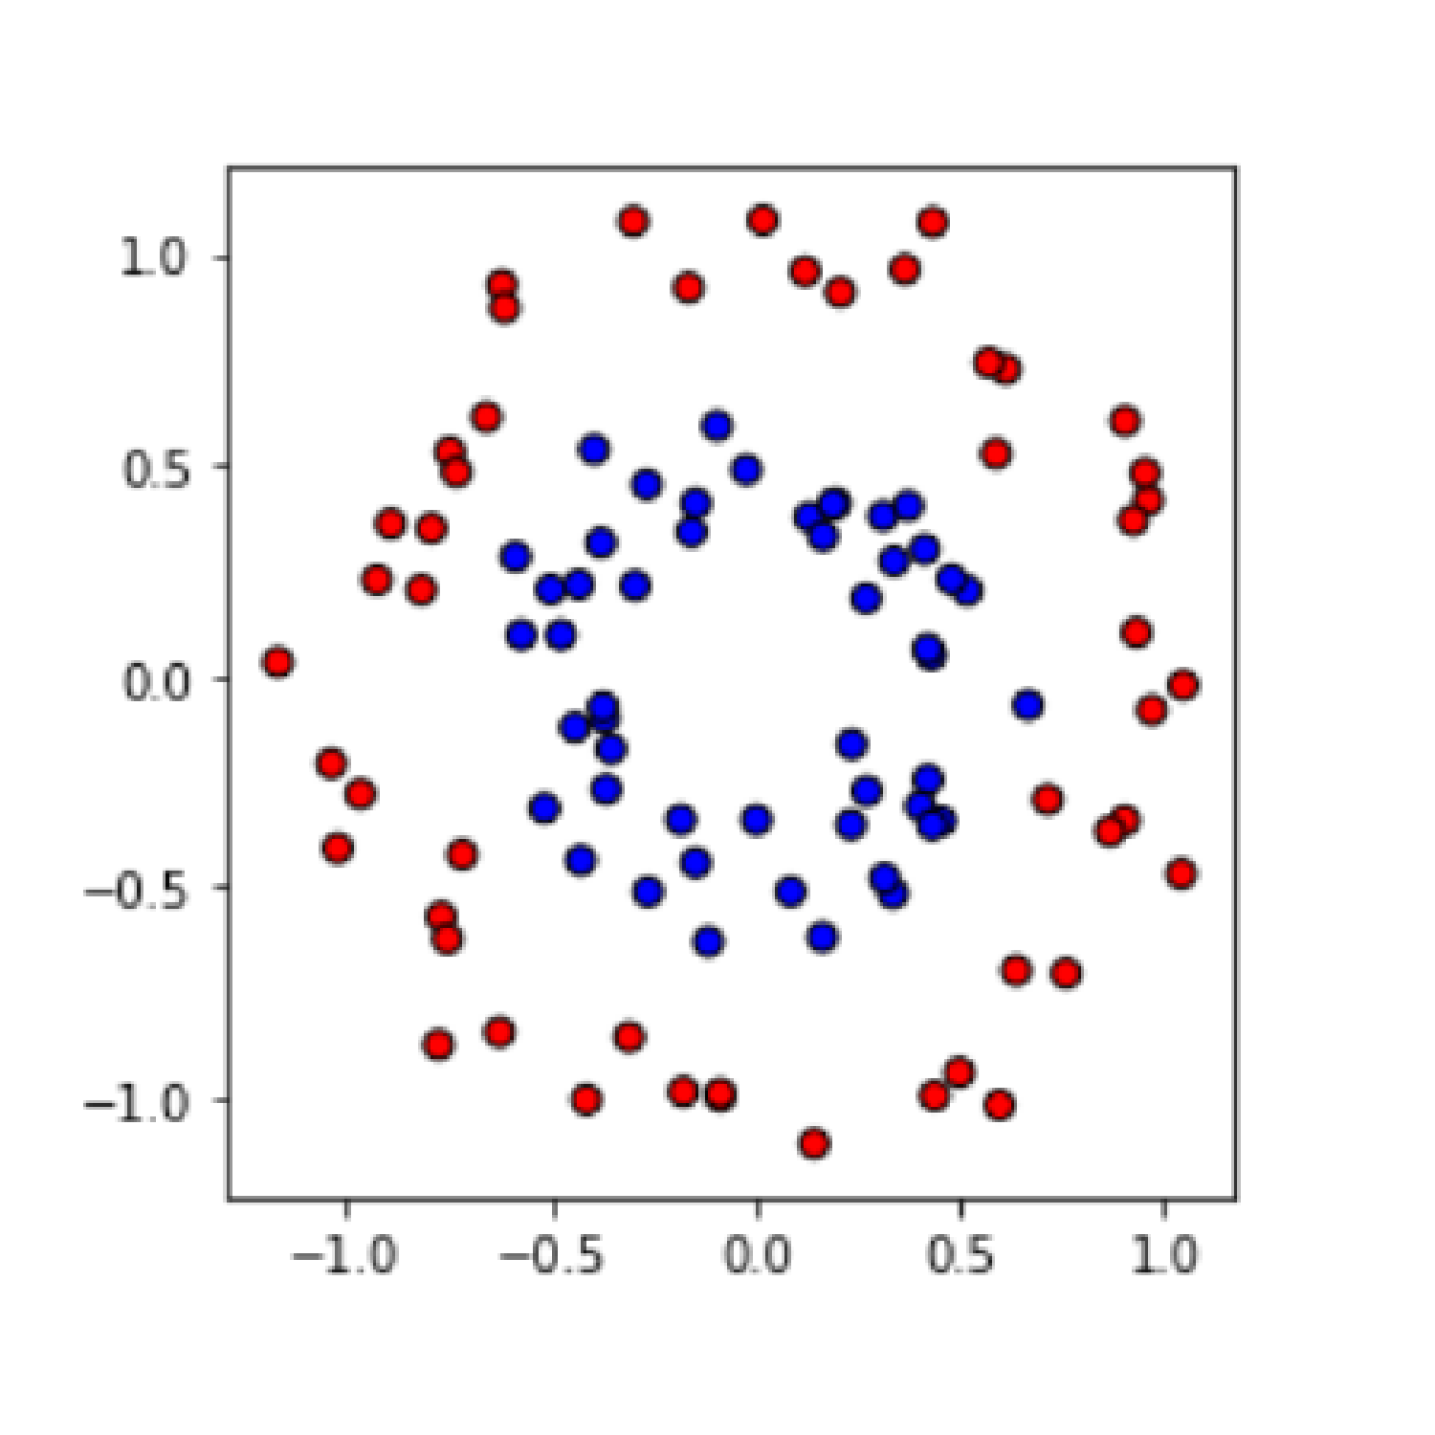
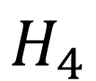




What about circular distributions?
$$H_{1}$$
$$H_{2}$$
$$H_{3}$$
$$H_{4}$$
$$H_{5}$$

Slide 40





What about circular distributions?
$$H_{1}$$
$$H_{2}$$
$$H_{3}$$
$$H_{4}$$
$$H_{5}$$

Slide 41

Artificial Neuron Compact Representation

Slide 42

Notation
With
$$W={\left(w_{1},…,w_{p}\right)}^{T}$$
$$X={\left(x_{1},…,x_{p}\right)}^{T}$$
We can simply write:
$$g\left(b+\sum_{i=1}^{p}{w_{i}x_{i} }\right)=g\left(b+W^{T}X\right)$$

Slide 43
Computation Graph
Definition
A computation graph is a directly acyclic graph such that:
A node is a mathematical operator
To each edge is associated a value
Each node can compute the values of its output edges from the values of its input edges
Nodes without input edges are input nodes. They represent the input values of the graph
Similarly, nodes without output edges are output nodes.
Computing a forward pass through the graph means choosing its input values and then progressively computing the values of all edges.

Slide 44
Computation Graph
Node
Another node
Edge
Input nodes
Output node(s)
Computing a forward pass through the graph means choosing its input values and then progressively computing the values of all edges.

Slide 45
Computation Graph Example
We will compute:
$$z=σ\left(w_{1}x+w_{2}y+b\right)$$
Where $σ$ is the sigmoid function $σ\left(x\right)=\frac{1}{1+e^{−x}}$
x
x
w₁
+
+
σ
z
y
x
w₂
b

Slide 46
Dense Graph Example
Each node is now a neuron

Slide 47


Activation: binary
$g\left(x\right)=\left\{\begin{aligned}1, if x>0 \\ &0, otherwise\end{aligned}\right.$
Remarks
Biologically inspired
Simple to compute
High abstraction
Gradient zero except in one point
In practice, almost never used

Slide 48


Activation: sigmoid
$g\left(x\right)=\frac{1}{1+e^{−x}}$
Remarks
Similar to binary, but with usable gradient
Gradient tends to zero when input is far from zero
More computationally expensive

Slide 49


Activation: hyperbolic tangent
$g\left(x\right)=\frac{e^{x}−e^{−x}}{e^{x}+e^{−x}}$
Remarks
Similar to sigmoid

Slide 50


Activation: rectified linear unit
$g\left(x\right)=\left\{\begin{aligned}x, if x>0 \\ &0, otherwise\end{aligned}\right.$
Remarks
Usable gradient when activated
Fast to compute
High abstraction

Slide 51
Neural Network (NN)
Definition
An artificial neural network is a computation graph, where the nodes are artificial neurons
The input layer is the set of neurons without incoming edges
The output layer is the set of neurons without outgoing edges

Slide 52

Feed-forward Neural Networks
Definition
A feed-forward neural network is a NN without cycles
Neurons are organized in layers
A neuron belongs to layer $q$ if the longest path in the graph between the input layer and the neuron is of length $q$.
Any layers other than input and output layers are called hidden layers
Feed-forward neural network is the most commonly used architecture and is the preferred type for image processing.

Slide 53

Fully Connected Networks
A layer is fully connected (FC) if each of its neurons are connected to all the neurons of the previous and following layers
If a FC layer contains $r$ neurons, and the previous layer $q$, then its weights are a 2-dimensinal matrix of size $q×r$
A NN is fully connected if all its hidden layers are fully connected

Slide 54


Graphical representations of NNs
A layer is fully connected (FC) if each of its neurons are connected to all the neurons of the previous and following layers
If a FC layer contains $r$ neurons, and the previous layer $q$, then its weights are a 2-dimensinal matrix of size $q×r$
A NN is fully connected if all its hidden layers are fully connected
Nodes are represented as a single array

Slide 55

Graphical representations of NNs
A layer is fully connected (FC) if each of its neurons are connected to all the neurons of the previous and following layers
If a FC layer contains $r$ neurons, and the previous layer $q$, then its weights are a 2-dimensinal matrix of size $q×r$
A NN is fully connected if all its hidden layers are fully connected
Nodes are represented as a single array
Edges are replaced with arrows denoting operations
A layer corresponds to an operator (and often an activation) as well as the resulting array

Slide 56

Graphical representations of NNs
A layer is said to be fully connected (FC) if each of its neurons are connected to all the neurons of the previous and following layers
If a FC layer contains $r$ neurons, and the previous layer $q$, then its weights are a 2-dimensinal matrix of size $q×r$
A NN is said to be fully connected if all its hidden layers are fully connected
Data is organized into arrays linked with operators
Edges are replaced with arrows denoting operations
A layer corresponds to an operator (and often an activation) as well as the resulting array

Slide 57

Training a Neural Network
How do we choose the set of parameters $θ=\left(W_{i},b_{i}\right)$ with the correct weights and biases for our particular problem?
How do we evaluate the performance?

Slide 58

Learning Problem
Recall that a training set contains $n$ samples:
$$\left(x_{i},y_{i}\right)∈ℝ^{p}×ℝ$$
We choose a family of $f_{θ}$ functions from $ℝ^{p}$ into $ℝ$, depending on our set of parameters $θ$, and find the value of $θ$ that minimizes a chosen loss function $L$:
$$θ^{∗}=\underset{θ}{arg min}{(L\left(θ\right))}$$

Slide 59

Loss Function
Evaluation is accomplished with a loss function
The loss function measures how wrong the network is when predicting the output $\hat{y}$ for an input $x$
A general form of the loss function is:
$$L(θ)=\sum_{i=1}^{n}{d(y_{i}, f\left(x_{i},θ)\right)}$$
Where $d$ is some disparity function (the more similar its parameters, the smaller its value).

Slide 60


Loss Function Examples
Squared error
$$L(θ)=\sum_{i=1}^{n}{{\left(y_{i},−f\left(x_{i},θ\right)\right)}^{2}}$$
This loss function is mainly used in regression problems
Binary cross-entropy
In this case, $y_{i}∈\left\{0,1\right\}$
$$L\left(θ\right)=−\sum_{i=1}^{n}{\left(y_{i}\log\left(f\left(x_{i},θ\right)\right)+\left(1−y_{i}\right)\log\left(1−f\left(x_{i},θ\right)\right)\right)}$$
This loss function is used in binary classification problems, where the network’s output can be interpreted as a probability of belonging to a class.

Slide 61


Gradient Descent
Definition
Gradient descent is an optimization algorithm. For a derivable function $L$, a positive real $γ$ (the learning rate) and a starting point $θ_{0}$, it computes a sequence of values:
$$∀e∈ℕ :θ_{e+1}=θ_{e}−γ∇L\left(θ_{e}\right)$$
Property
If $γ$ is small enough, then
$$L\left(θ_{i+1}\right)≤L\left(θ_{i}\right)$$
Gradient descent is an essential tool in optimization.

Slide 62


Gradient Descent in the scalar case
$$θ_{t+1}=θ_{t}−γ∇L\left(θ_{t}\right)$$

Slide 63

Gradient Descent: Stopping Criteria
In practice:
$$∀e∈\left[0,…,E−1\right] : θ_{e+1}=θ_{e}−γ∇L\left(θ_{e}\right)$$
Choose $E$ (the number of epochs) based on experience
Track the quality of the model using a validation dataset and stop when the validation loss does not improve

Slide 64

Stochastic Gradient Descent
The loss function we initially defined depends on the whole training set:
$$L(θ)=\sum_{i=1}^{n}{d(y_{i}, f\left(x_{i},θ)\right)}$$
If $n$ is very large, its computation is not feasible.
A computation on the whole training set leads to a single update of the model parameters – convergence can therefore be slow.

Slide 65

Stochastic Gradient Descent
In stochastic gradient descent, the parameters are updated for each sample $i$:
First, the loss is computed
$$L(θ_{t})=d(y_{i}, f\left(x_{i},θ_{t})\right)$$
The gradient $∇L(θ_{t})$ is computed using an algorithm called backpropagation
Finally, the parameters are updated:
$$θ_{t+1}=θ_{t}−γ∇L\left(θ_{t}\right)$$
Note that the learning rate $γ$ can have a different value
Notes:
In practice,

Slide 66

Extracting Semantic Information from an Image
Where is the person? (localization task)
How many monitors are there? (quantification task)
At what time of day was the photo taken?
Designing computer vision systems that are
able to extract semantic information from an
image is a difficult task

Slide 67
The role of annotated image databases
Image databases including annotations (typically some kind of high level information) are
essential to the development of supervised machine learning methods for image analysis.
Annotations include:
Image class
Measure(s) obtained from the image
Position of objects within the image
Segmentation

Slide 68
Deep Learning Image Applications
Classification
Object localization
Semantic segmentation
Instance segmentation
Transformation (filtering, in-painting, editing, colorization, ...)
Quantification
Compression
Image caption generation
2D to 3D (stereo matching, 3D reconstruction, …)
Motion estimation
Style transfer
Anomalous image detection
Image generation

Slide 69
Deep Learning Image Applications
Semantic segmentation
Image generation

Slide 70
Convolutional Neural Networks (CNN) in Deep Learning
They are pivotal to many of the successes achieved by neural networks in recent years
They are interesting for dealing with regular structured data, such as images (or board games, like chess or ‘Go’)

Slide 71

Input Image, Input Neurons

Slide 72
Input Image, Input Neurons

Slide 73


Image classification problem
Classification problem:
Input: image $x$
Output: class $y∈ \left\{{label}_{1}, {label}_{2}, …, {label}_{q}\right\}$
If there are $q$ possible classes, then a class will be coded as a vector $y$ of length $q$. If its class is $r$ then for $0≤i<q$:
$$y\left[i\right]=\left\{\begin{aligned}1, i=r \\ &0, otherwise\end{aligned}\right.$$
Example with 4 classes
Label 0 $→\left[1, 0, 0, 0\right]$
Label 1 $→\left[0, 1, 0, 0\right]$
Label 2 $→\left[0, 0, 1, 0\right]$
Label 3 $→\left[0, 0, 0, 1\right]$

Slide 74


Image classification with a neural network
Input
Example: Image with $2×4$ pixels, $4$ possible classes
The input image, containing $p$ pixels, is transformed into a vector of length $p$.
Output
For $q$ classes, the output will be a vector of length $q$.

Slide 75





Image classification using fully connected layers
A small image contains at least $100.000$ pixels
The number of parameters between two layers of that size is ${10}^{5}×({10}^{5}+1)$
This is not feasible
It does not take local structures of the image into account
$$316 px$$
$$500 px$$
$$=158.000 px$$

Slide 76



Towards convolutional layers

Slide 77

Towards convolutional layers
Input values
Kernel
Output values

Slide 78



Stride

Slide 79



Several filters in the same convolutional layer

Slide 80



Max pooling
CNN’s often contain subsampling steps. A common way of doing this is by using max pooling layers with a stride of 2
Sampling is then only applied along the spatial dimension(s), not along the dimension of the filters

Slide 81
Main Components of a CNN
Many successful architectures, especially for image classification, follow the same pattern:
Several iterations of: one or more convolutional layers, with increasing depth, followed by max pooling
A few fully connected layers

Slide 82

1D Representation

Slide 83

Current Trends
Small convolutions $\left(3×3\right)$
Dimension reduction using $1×1$convolutions
Increasing number of layers
Skip connections (connections between non-neighboring layers)

Slide 84
Some deep learning libraries
Deep learning is a very competitive domain, where code sharing is very common.
Tensorflow, by Google
PyTorch, Torch (Facebook)
Caffe, (Univ. of Berkeley)
Microsoft Cognitive Toolkit (CNTK)
MatConvNet (for Matlab)
Theano (no longer maintained)
Comments
Most of these libraries use Python as prototyping language
Keras is a very easy to use interface to both Tensorflow, Theano and CNTK.

Slide 85
A revolution in image analysis
Deep learning has brought an undeniable breakthrough in image analysis
A significant part of research efforts in image analysis today is based on deep learning
Its applications are ubiquitous
Limitations
For a deep-learning solution to work, you need:
Enough annotated data
A lot of fiddling (different architectures; hyper-parameters, optimization)
One (or, even better, more) powerful GPU’s
Moreover, these models lack interpretability

Slide 86

Image-to-Image NN
Definition
An image-to-image NN is a CNN, denoted $F$, that transforms an input image into an
image of the same size:
$$F :ℐ^{d_{1}}⟶ℐ^{d_{2}}$$
$$I⟶F\left(I\right)$$
Note that the dimensions $d_{1}$ and $d_{2}$ of the value spaces can be different.

Slide 87

Image Segmentation with NNs
Image segmentation often is an important step in an image processing workflow
Image segmentation has been a very active deep learning research field

Slide 88
Image Segmentation with NNs
Image segmentation often is an important step in an image processing workflow
Image segmentation has been a very active deep learning research field

Slide 89

PART II

Slide 90


Preprocessing Raw Data
”Flat-field” Correction

Slide 91

Preprocessing Raw Data
”Flat-field” Correction

Slide 92


Preprocessing Raw Data
Register landmarks

Slide 93

Preprocessing Raw Data
Transform image

Slide 94




Creating Ground Truths
Careful process
Multiple modalities complicate matters

Slide 95
Creating Ground Truths
Careful process
Multiple modalities complicate matters
The Devil’s in the details

Slide 96

Image-to-Image NN Architecture
Image-to-image NNs are based on convolutional layers
If downsampling is used, the corresponding upsampling is needed

Slide 97


Software and Current Results
Python 3.6
TensorFlow, by Google
Keras
U-Net Architecture
U-ResNet architecture

Slide 98




Software and Current Results
Both networks are able to converge
U-ResNet has fewer filters
U-Net has many inactive filters
Achieves higher accuracy
U-ResNet
U-Net

Slide 99
Software and Current Results
U-ResNet
U-Net
Both networks are able to converge
U-ResNet has fewer filters
U-Net has many inactive filters
Achieves higher accuracy

Slide 100

Software and Current Results
Both networks are able to converge
U-ResNet has fewer filters
U-Net has many inactive filters
Achieves higher accuracy
Overall shape looks good

Slide 101
Software and Current Results
Both networks are able to converge
U-ResNet has fewer filters
U-Net has many inactive filters
Achieves higher accuracy
Overall shape looks good
Semantic segmentation accuracy subpar

Slide 102
Outlook and Conclusion
Continue experimenting with network architectures
Acquire additional data (images and labels)
Are Neural Networks feasible for you?
Tensorflow 2.0 and tf.keras makes NNs increasingly simple to build
Less knowledge required
Focus on data rather than network

Slide 103





Thank you for your attention!
Acknowledgements
Assoc. Prof. Jonathan R. Brewer
Director of DaMBIC-NAT
Dr. Thomas Walter
Director of Centre for Computational Biology (CBIO)
Dr. Vita Solovyeva
DaMBIC Core Facility Manager
Dr. Christian Godballe
Clinical Professor at Oto-rhino-laryngology, OUH
Dr. Stine Rosenkilde Larsen
Consultant at Department of Pathology, OUH

